Slide 1
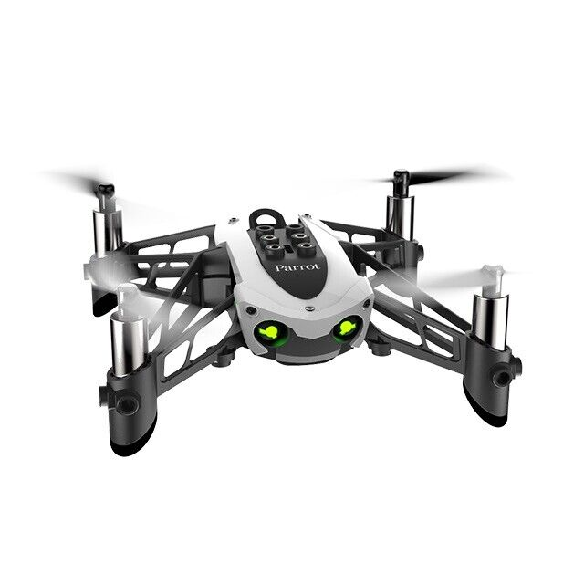
Reinforcement Learning for Parrot Mambo Minidrone Attitude Control
Mehmet SAKARYA
Mücahid Rıdvan KAPLAN
Computer Engineering & Hacettepe University
25 April, 2024
Notes:
Hello, today we will present to you the project proposal titled 'Reinforcement Learning for Parrot Mambo Minidrone Attitude Control'.

Slide 2
Outline
Introduction and Problem Statement
Some Reinforcement Learning Algorithms
Reinforcement Learning for Control Systems Applications
Literature Review
Quadcopter Flight Simulation Model
Flight Control System Structure
Project Stages and Methodology
Expected Results and Contributions
Notes:
Our presentation will follow this outline: Firstly, we will discuss the introduction and problem statement. Then, we will briefly overview some RL algorithms commonly used in quadcopters. We will simulate the RL agent using the concept of feedback control in control theory. We will summarize two articles briefly through a literature review. We will describe the proposed quadcopter simulation model and flight control system structure. Finally, we will discuss the project's stages, expected results, and contributions to the literature before concluding the presentation.

Slide 3
Outline
Introduction and Problem Statement
Some Reinforcement Learning Algorithms
Reinforcement Learning for Control Systems Applications
Literature Review
Quadcopter Flight Simulation Model
Flight Control System Structure
Project Stages and Methodology
Expected Results and Contributions
Notes:
No comment

Slide 4
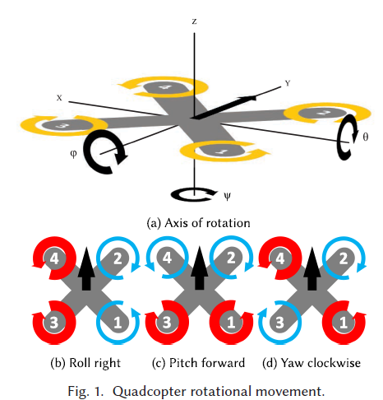
Introduction and Problem Statement
Flight control systems generally composed of;
Position & altitude control
Speed control
Navigation control
Attitude control
PID (Proportional-Integral-Derivative) controllers are used due to their simplicity, stability and real time response capabilities.
While PID systems adequate for lots of operations, it has some challenges.
Notes:
In this project we focused on attitude control which controls the orientation with roll, pitch, yaw angles.

Slide 5
Challenges with PID Controllers
Limitations in Varying Environments
PID controllers struggle with unknown dynamics such as wind and voltage sag.
Adaptability Requirement
Next-gen systems need to adapt to mutable dynamics and varying environments.
Performance in Stable Environments
PID controllers perform close to ideally in stable conditions.
Notes:
Here are the main problem for PID controller is that it exhibits close to ideal performance in stable environment. However, when exposed to unknown Dynamics it can be far from optimal solution. Therefore, it is needed to adapt the PID controller to varying environment.

Slide 6
Issues with Supervised Learning
Expensive Data Acquisition
Data required for supervised learning is costly to obtain.
Inaccurate Aircraft Dynamics
The use of inaccurate representations of aircraft dynamics can lead to suboptimal control policies.
Suboptimal Control Policies
Inaccurate data can result in suboptimal control policies, impacting flight safety and performance.
Notes:
One way to make intelligent flight controller system is that supervised Learning method.
However, it is also problematic because obtaining the data is expensive and derived from inaccurate representations can lead to suboptimal control policies.

Slide 7
Outline
Introduction and Problem Statement
Some Reinforcement Learning Algorithms
Deep Deterministic Policy Gradient (DDPG) Algorithm
Trust Region Policy Optimization (TRPO) Algorithm
Proximal Policy Optimization (PPO) Algorithm
Reinforcement Learning for Control Systems Applications
Literature Review
Quadcopter Flight Simulation Model
Flight Control System Structure
Project Stages and Methodology
Expected Results and Contributions

Slide 8
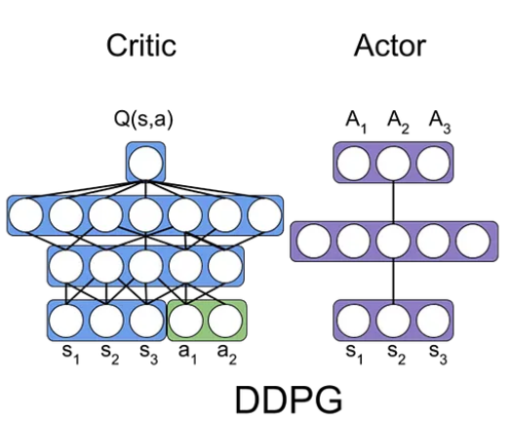
Deep Deterministic Policy Gradient (DDPG) Algorithm
Model-free, online, off-policy reinforcement learning method
DDPG agent is an actor-critic reinforcement learning agent
Actor: takes state and returns corresponding actions
Critic: takes observation and action as input and return corresponding expectation of the long term reward
Notes:
Actor-critic 🡪 searches for an optimal policy that maximizes the expected cumulative long-term reward.
How DDPG (Deep Deterministic Policy Gradient) Algorithms works in reinforcement learning ? | by Amaresh Marekar | Medium
Actor : decides by selecting actions based on the current policy (policy is modelled)
explores the action space to maximize reward
Critic : value function , evaluates the actions
estimates the value of actions by providing feedback on their performance

Slide 9
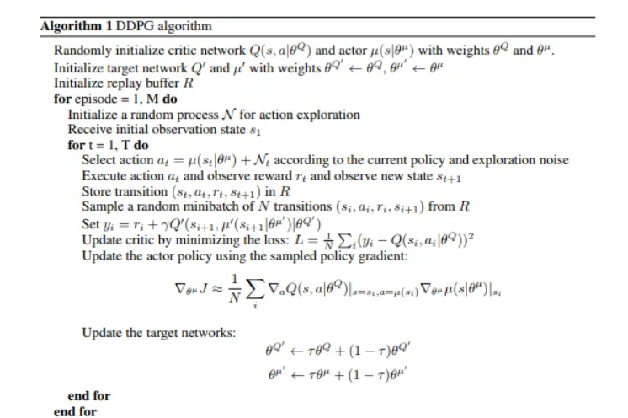
Notes:
Deep Deterministic Policy Gradients Explained | by Chris Yoon | Towards Data Science

Slide 10
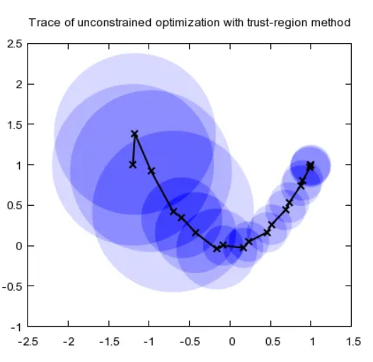
Trust Region Policy Optimization (TRPO) Algorithm
Model-free, online, on-policy, policy gradient reinforcement learning algorithm
Working process is
Decide step size α
Construct a circle with radius α (trust region)
Once having the best point, determine the direction
Repeat until the optimal point is reached

Slide 11
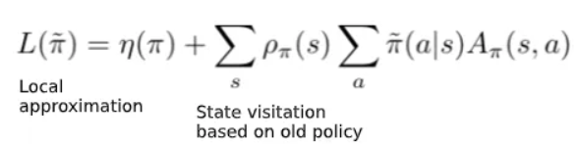
The goal is to optimize the objective function η(π).
Notes:
Trust Region Policy Optimisation(TRPO) — a policy-based Reinforcement Learning | by Dhanoop Karunakaran | Intro to Artificial Intelligence | Medium
Trust Region Policy Optimisation(TRPO) — a policy-based Reinforcement Learning | by Dhanoop Karunakaran | Intro to Artificial Intelligence | Medium

Slide 12
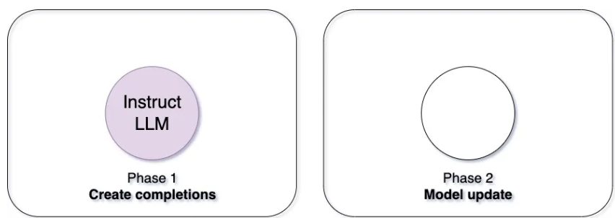
Proximal Policy Optimization (PPO) Algorithm
3 main advantages:
Simplicity
Stability
Sample efficiency
Easier to implement and tune while performing well in challenging environments.
Instead of making big changes all at once, PPO encourages small and gradual improvements.
Notes:
“Proximal” means staying close to the original style
“Policy Optimization” is about finding better strategies.

Slide 13
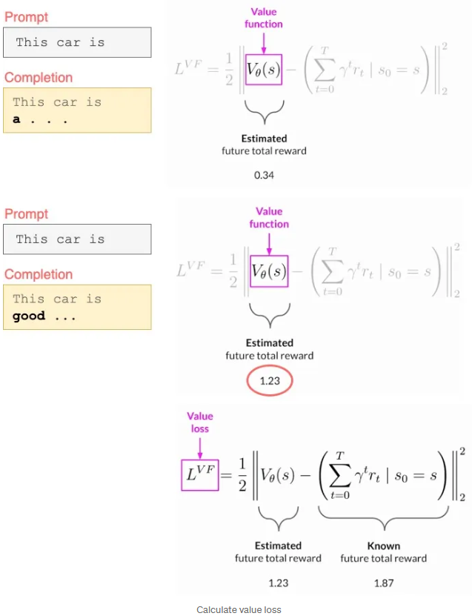
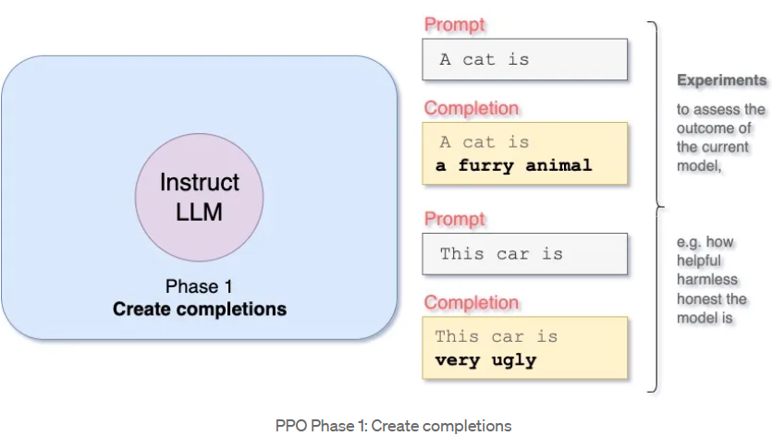
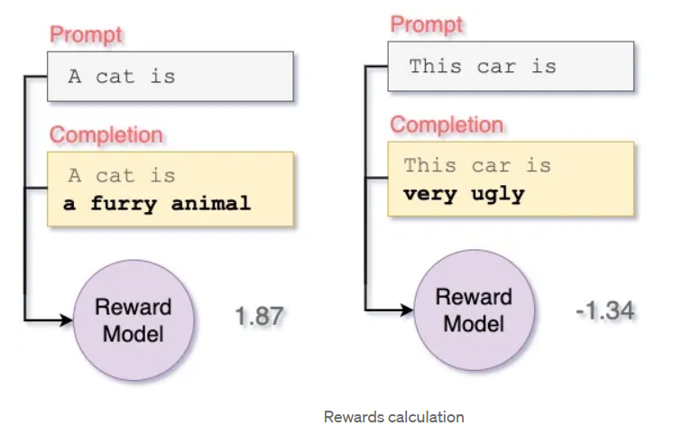
PHASE – I
Notes:
In Phase I, the LLM performs several experiments by completing provided prompts.
reward model represents human preferences i.e helpfulness, safety, and honesty of the responses
Each completion is paired with its corresponding reward.

Slide 14
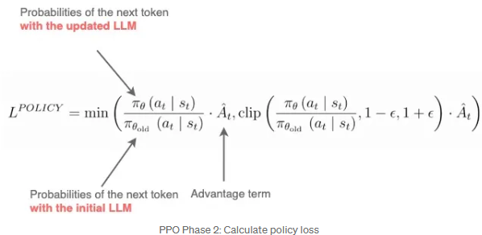
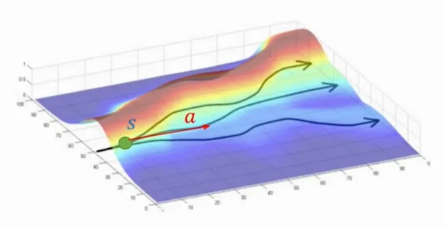
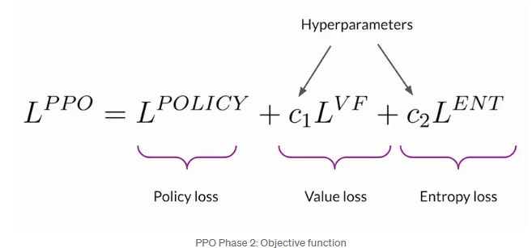
PHASE – II

Slide 15
Outline
Introduction and Problem Statement
Some Reinforcement Learning Algorithms
Reinforcement Learning for Control Systems Applications
Literature Review
Quadcopter Flight Simulation Model
Flight Control System Structure
Project Stages and Methodology
Expected Results and Contributions
Notes:
No comment

Slide 16
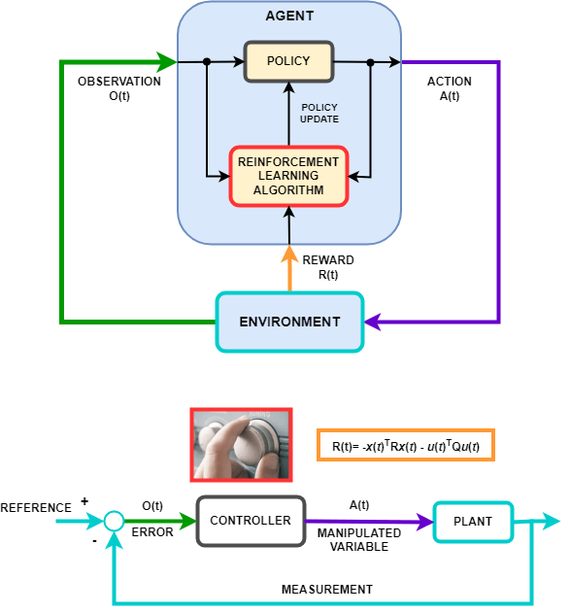
Reinforcement Learning for Control Systems Applications
Notes:
We can liken an RL agent to the structure of a feedback control system. In RL, the action corresponds to the control signal in control theory. The observation signal in RL is defined as the error between the reference and feedback in control. The environment in RL includes the reference, measurement, and plant in control. The defined reward function aims to maximize or minimize it.

Slide 17
Outline
Introduction and Problem Statement
Some Reinforcement Learning Algorithms
Reinforcement Learning for Control Systems Applications
Literature Review
Article 1 - RL for UAV attitude control
Article 2 - Attitude Control of Quad-copter using deterministic policy gradient algorithms
Quadcopter Flight Simulation Model
Flight Control System Structure
Project Stages and Methodology
Expected Results and Contributions

Slide 18
Article 1 – RL for UAV attitude control
Specific Focus
Deep dive into the accuracy and precision of attitude control using intelligent flight controllers trained with RL.
Training Environment
Introduction of GymFC, an OpenAI Environment, designed for training intelligent flight control systems.
RL Application
Application of RL algorithms for attitude control and their potential transfer to physical hardware.
Koch, William, et al. "Reinforcement learning for UAV attitude control." ACM Transactions on Cyber-Physical Systems 3.2 (2019): 1-21.
Notes:
As an alternative way to the supervised learning method to make intelligent flight control system is using the RL algorithms as this projects main aim.
This Project focuses on intelligent flight controller with RL algorithms to make better accuracy and precision of attitude control.

Slide 19
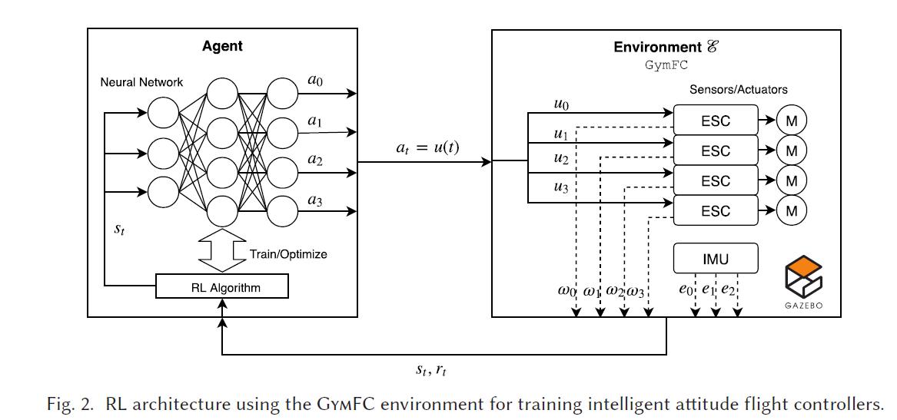
Environment

Slide 20
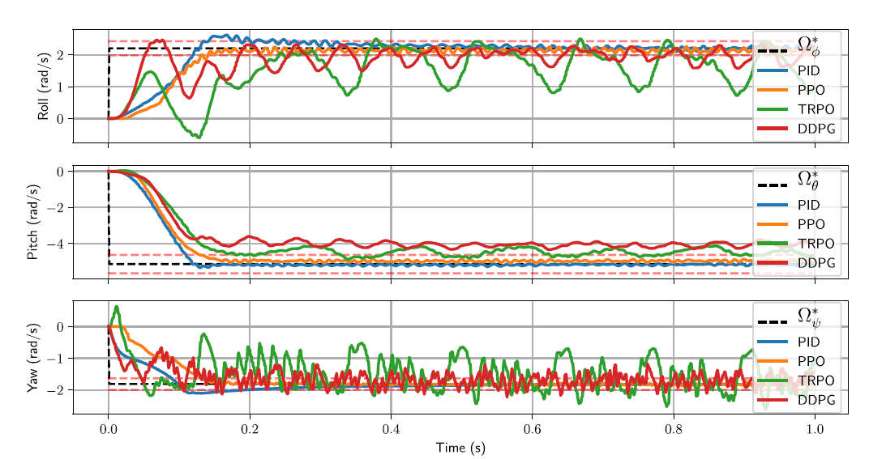
Results

Slide 21
Article 2 – Attitude Control of Quad-copter using DPGA
Specific Focus
Controlling the quadcopter by using DDPG & D4PG RL algorithms.
Training Environment
GymFC for training intelligent flight control of quadcopter.
RL Application
Comparative analysis of the performance of DDPG &D4PG algorithms in terms of reward generation, actor loss, and critic performance.
Ghouri, Usama Hamayun, et al. "Attitude control of quad-copter using deterministic policy gradient algorithms (DPGA)." 2019 2nd International Conference on Communication, Computing and Digital systems (C-CODE). IEEE, 2019.

Slide 22
DDPG & D4PG Algorithms
DDPG: Deep Deterministic Policy Gradient
D4PG : Distributed Distributional Deterministic Policy Gradient
Extended and enhanced algorithm of DDPG for improving :
Stability
Sample efficiency
Performance

Slide 23
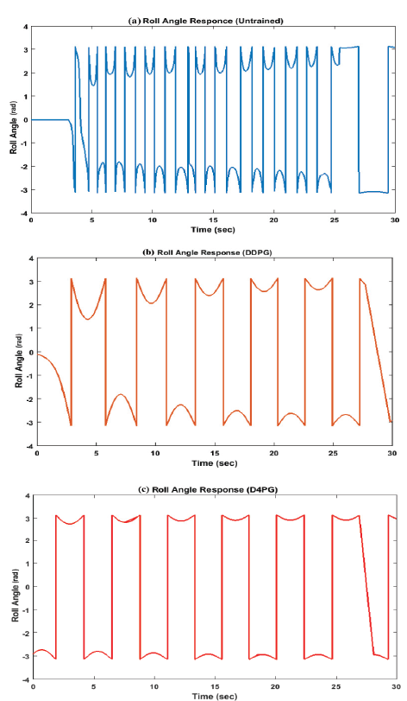
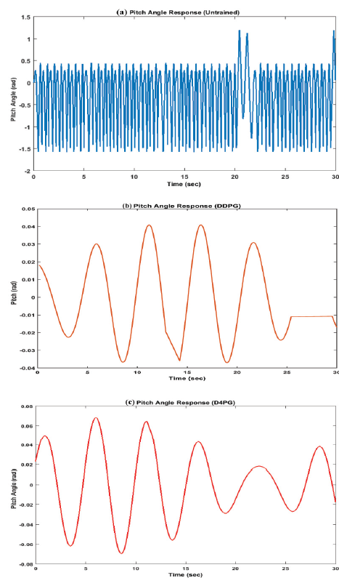
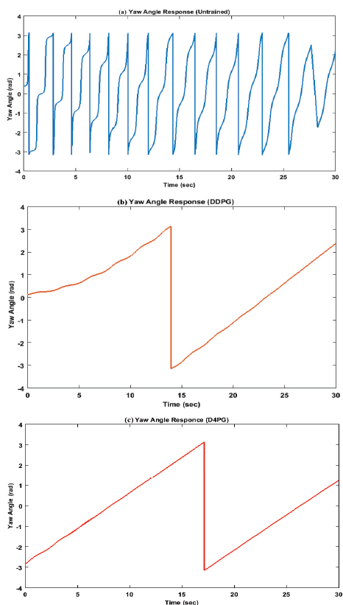
Angle Stabilization Performances

Slide 24
Outline
Introduction and Problem Statement
Some Reinforcement Learning Algorithms
Reinforcement Learning for Control Systems Applications
Literature Review
Quadcopter Flight Simulation Model
Flight Control System Structure
Project Stages and Methodology
Expected Results and Contributions
Notes:
No comment

Slide 25
Quadcoper Flight Simulation Model
Notes:
In this block diagram, we see the simulation model structure in the Matlab/Simulink environment. The Signal Editor block generates position and attitude commands. The Nonlinear Airframe block contains the nonlinear model of the quadcopter. The Sensors block includes the model of sensors such as IMU on the quadcopter. The Visualization block facilitates logging and scoping of commands, control signals, and states, it contains also workspace and Simulink 3D animation. The Environment block includes gravity, air temperature, speed of sound, pressure, air density, and magnetic field. The Flight Control System block is responsible for position and attitude control. Here, we will perform attitude control using RL (Reinforcement Learning)

Slide 26
Outline
Introduction and Problem Statement
Some Reinforcement Learning Algorithms
Reinforcement Learning for Control Systems Applications
Literature Review
Quadcopter Flight Simulation Model
Flight Control System Structure
Project Stages and Methodology
Expected Results and Contributions
Notes:
No comment

Slide 27
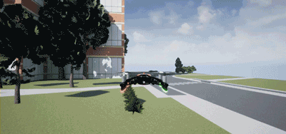
Flight Control System Structure
RL Agent
RL Agent
Notes:
The blue-colored Flight Control System block in the previous slide will contain an XY position controller, a z position controller for altitude, roll and pitch attitude controllers for stability, and a yaw attitude controller. Here, we will design the roll, pitch, and yaw controllers using an RL agent.
Here, we will not be training all three angles simultaneously. First, we'll train the roll/pitch angles with RL for stability, then we'll train the yaw angle. This is because, due to the unstable system dynamics, the default roll/pitch controller in the Parrot Mambo is different from the yaw controller in order to ensure stability. Therefore, we're planning to design a multi-agent reinforcement learning approach.

Slide 28
Solution Approach
Reinforcement Learning (RL) stands out as a powerful technique for making optimal decisions in dynamic and uncertain environments.
In this project, we aim to develop an RL-based agent to control the attitude angles of the quadcopter.
The agent will learn optimal motion policies by observing and interacting with the quadcopter's environment.
RL Algorithms : Deep Deterministic Policy Gradient (DDPG) , Proximal Policy Optimization (PPO)

Slide 29
Outline
Introduction and Problem Statement
Some Reinforcement Learning Algorithms
Reinforcement Learning for Control Systems Applications
Literature Review
Quadcopter Flight Simulation Model
Flight Control System Structure
Project Stages and Methodology
Expected Results and Contributions
Notes:
No comment

Slide 30
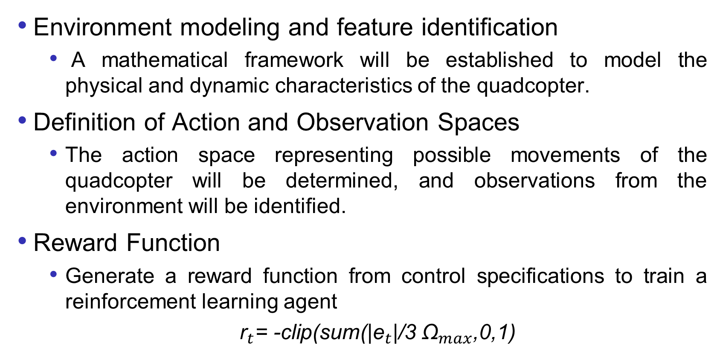
Project Stages and Methodology
Environment modeling and feature identification
A mathematical framework will be established to model the physical and dynamic characteristics of the quadcopter.
Definition of Action and Observation Spaces
The action space representing possible movements of the quadcopter will be determined, and observations from the environment will be identified.
Reward Function
Generate a reward function from control specifications to train a reinforcement learning agent
${\text{r}}_{t}$= -clip(sum(|${\text{e}}_{t}$|/3 ${\text{Ω}}_{max}$,0,1)
Notes:
Firstly, we will derive the nonlinear mathematical model of the quadcopter or use an open-source model for this framework. Then, we will decide on the action space reduced to the quadcopter’s four actuators and determine the sensor or estimated observation spaces. Finally, after establishing the observation and action structure, we will generate a reward function containing normalized attiude error to train the reinforcement learning agent."

Slide 31
Project Stages and Methodology
Agent Architecture and Training Algorithm
An RL algorithm will be selected
Deep Deterministic Policy Gradient (DDPG) Algorithm
Proximal Policy Optimization (PPO) Algorithm
The agent's architecture will be designed to initiate the training process.
Simulation Implementation
The developed agent will be tested in simulation environment.
Notes:
We will first train with two different RL algorithms, DDPG and PPO, for roll/pitch angle control, and then utilize multi-agent RL to train yaw angle control. We will test the results in the Matlab/Simulink environment.

Slide 32
Outline
Introduction and Problem Statement
Some Reinforcement Learning Algorithms
Reinforcement Learning for Control Systems Applications
Literature Review
Quadcopter Flight Simulation Model
Flight Control System Structure
Project Stages and Methodology
Expected Results and Contributions
Notes:
No comment

Slide 33
Expected Results and Contributions
It is expected that the RL-based agent will outperform traditional PID controllers.
Significant improvements in quadcopter attitude control under more flexible, adaptive, and uncertain conditions are targeted.
This study may inspire industrial applications by highlighting the potential of RL in the future development of quadcopter control systems.
Notes:
This adaptation will provide insights into the effectiveness of different RL algorithms for UAV attitude control in a specific simulation environment, potentially leading to advancements in autonomous drone control systems.

Slide 34
Thanks for listening.
Notes:
No comment

